Slide 1
ACIT 1630 Relational Database & SQL
Ed sweeney

Slide 2
Course Objective
Understand relational databases:
Design
Data modeling
SQL programming

Slide 3
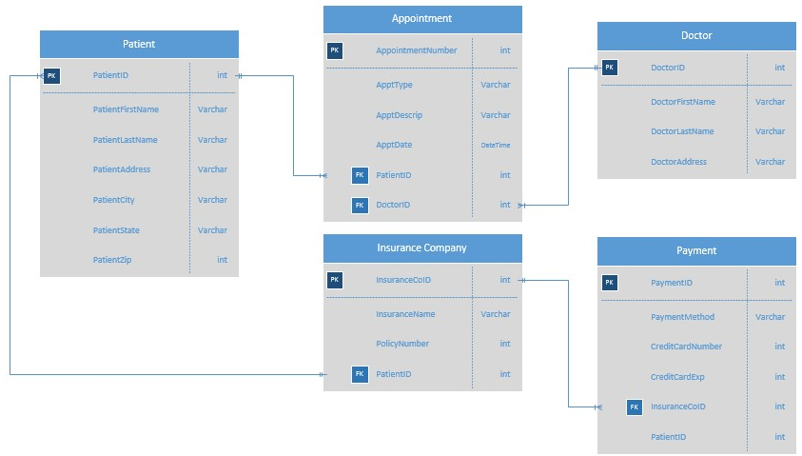
Course objective – Design and Model
https://d2vlcm61l7u1fs.cloudfront.net/media%2F034%2F034700fc-0cf1-4547-aa20-90971396d240%2FphpT3NEpo.png

Slide 4
Course Objective - SQL
SELECT O.OrderNumber, O.OrderDate, P.ProductName, I.Quantity, I.UnitPrice FROM Order AS O INNER JOIN OrderItem AS I ON O.Id = I.OrderId INNER JOIN Product AS P ON P.Id = I.ProductId ORDER BY O.OrderNumber DESC

Slide 5

Required Textbook
Database Systems Design, Implementation, and Management 13th Edition Coronel, Morris, Rob Hardcover, eBook or Looseleaf https://www.nelsonbrain.com/shop/isbn/9781337627900
Required for Weekly Readings, Questions, and Reviews

Slide 6
Course Marks
Final | 30% | Must have combined average of 50% to pass course.
Midterm | 30%
Projects | 20% | All Projects must be submitted to pass the course.
Exercises and Quizzes | 20% | All Assignments must be submitted to pass the course.
Passing grade is 50%

Slide 7
attendance
Attendance is Mandatory
If absent - must email me at: esweeney2@bcit.ca
Unexcused absences may lead to failure from this course.

Slide 8
Weekly In-class quizzes
There will be an in-class weekly quiz.
At the start of class.
If you are late for class you will miss the quiz.

Slide 9

Exercises AND PROJECTs
Late exercises and projects will NOT be accepted.
Late exercises and projects will be given a grade of 0.
http://www.fakenham-inf.norfolk.sch.uk/wp-content/uploads/2015/03/late_clock.png

Slide 10
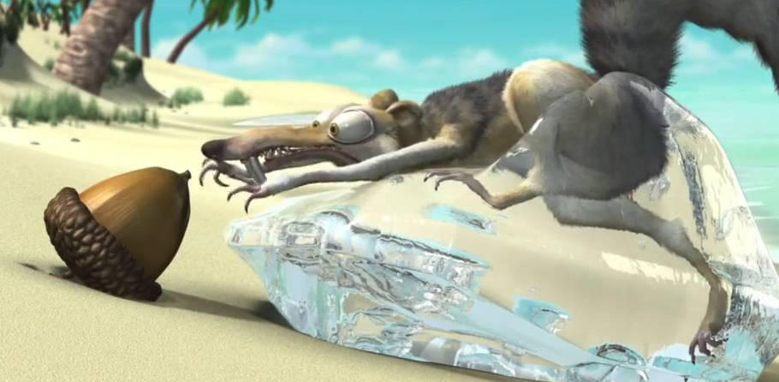
ICE BREAKER
A comfortable classroom helps students learn better.
https://m.media-amazon.com/images/M/MV5BYmQ1YTc5NmEtYzAzMi00MTE2LTlkMzgtYWYyNWFiMTI1ODRlXkEyXkFqcGdeQXVyNTQzMTI1MTc@._V1_.jpg

Slide 11
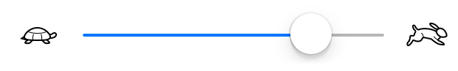
Anonymous survey
Please complete the anonymous survey
20 minutes
This will help me best teach the class
https://cdn.dribbble.com/users/4531/screenshots/1347935/untitled-1.png

Slide 12
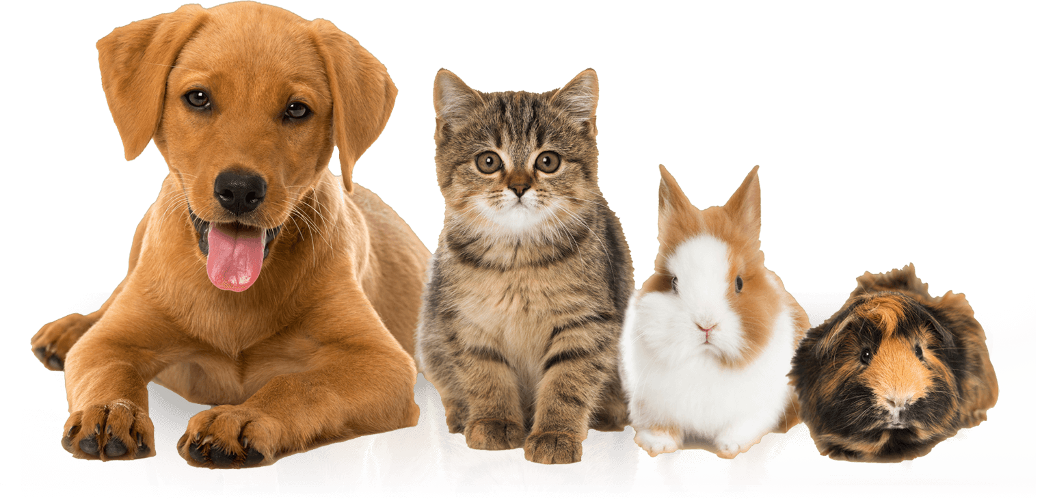
Pet Exercise
For both sheets (Design 1 and Design 2): Fill in your name and your pet(s).
https://avada.theme-fusion.com/veterinarian/wp-content/uploads/sites/80/2016/11/pets_big.png

Slide 13
Pet Exercise
Design 1
Person Table
Firstname | Lastname | Pets
Ed | Sweeney | Huckleberry (dog), Mickey (fish)
Sally
Fields
(cat)
Bubbles
https://avada.theme-fusion.com/veterinarian/wp-content/uploads/sites/80/2016/11/pets_big.png

Slide 14
Pet Exercise
Design 2
Person Table
ID | Firstname | Lastname
1 | Ed | Sweeney
2
Sally
Fields
Remember your Person ID
https://avada.theme-fusion.com/veterinarian/wp-content/uploads/sites/80/2016/11/pets_big.png

Slide 15
Pet Exercise
Pet Type Table
ID | Type
1 | Dog
2 | Cat
3
Design 2
Fish
Pet Table
ID | Petname | Type ID | Person ID
1 | Kobe | 1 | 1
2 | Fluffy | 2 | 1
3
Bubbles
2
Person ID
https://avada.theme-fusion.com/veterinarian/wp-content/uploads/sites/80/2016/11/pets_big.png

Slide 16

Your favourite?
Timbits
OR
Chocolate
https://www.kesher.org.il/wp-content/uploads/2018/08/set-icons-1562158_960_720.png

Slide 17
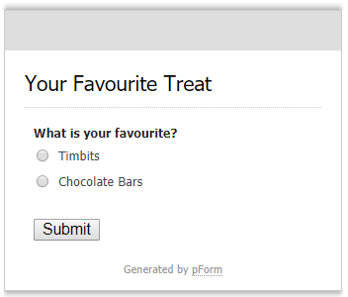
Your favourite?

Slide 18
Your favourite?

Slide 19
Data vs information
Data
Raw (unprocessed) facts
Information
Processing data to reveal meaning

Slide 20
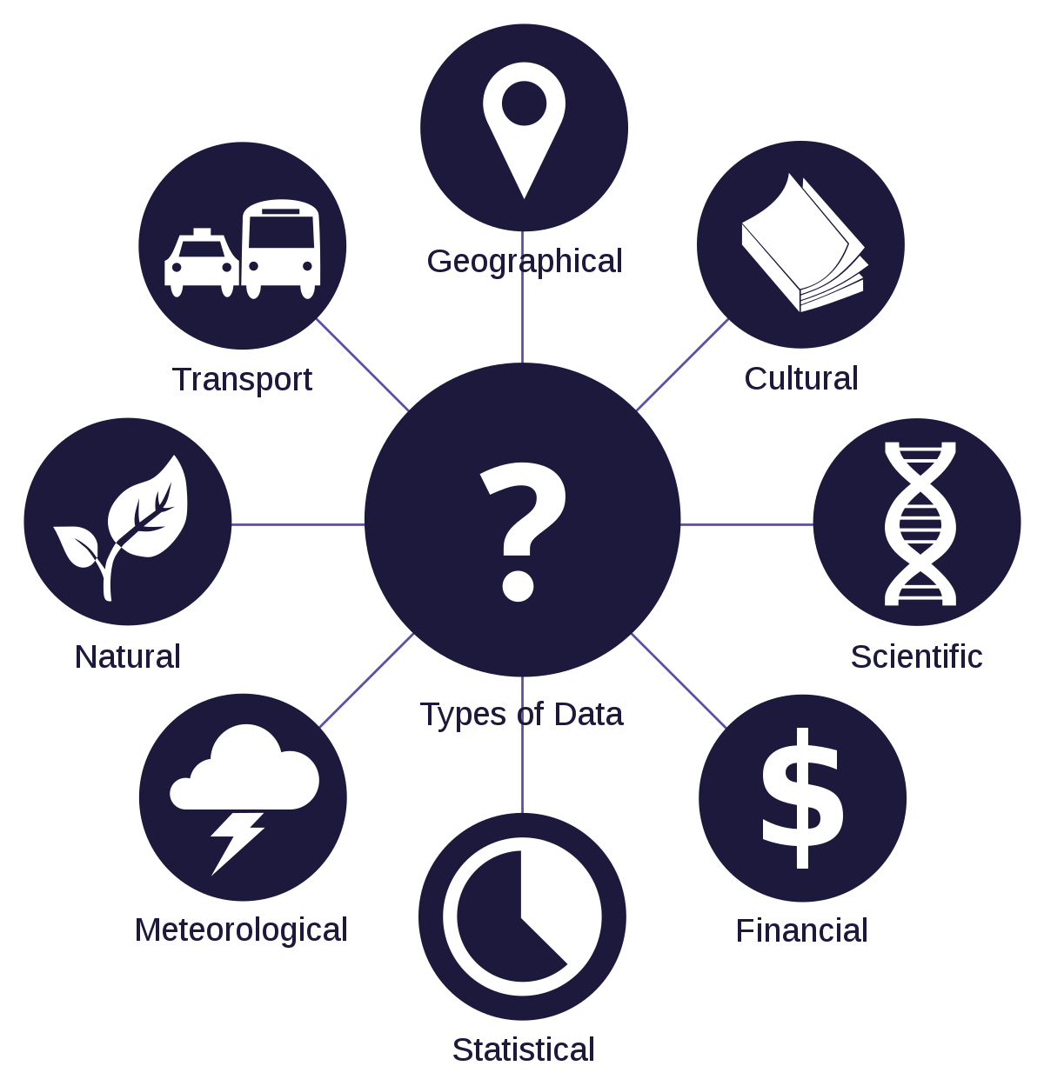
Sources of data
https://upload.wikimedia.org/wikipedia/commons/thumb/6/6d/Data_types_-_en.svg/1200px-Data_types_-_en.svg.png

Slide 21
Database comparison
What are the most popular database software, and why?
In groups of 4

Slide 22







Relational databases
Open Source
Proprietary
https://upload.wikimedia.org/wikipedia/commons/thumb/3/30/Microsoft_Office_Access_%282013%E2%80%93present%29.svg/1200px-Microsoft_Office_Access_%282013%E2%80%93present%29.svg.png
https://cdn.freebiesupply.com/logos/large/2x/mysql-logo-png-transparent.png
https://mariadb.org/wp-content/uploads/2017/03/MariaDB-Foundation-vertical.png
https://www.baaer.eu/wp-content/uploads/2018/07/Slide1.jpg https://seeklogo.com/images/M/microsoft-sql-server-logo-96AF49E2B3-seeklogo.com.png
https://zdnet4.cbsistatic.com/hub/i/r/2018/04/19/092cbf81-acac-4f3a-91a1-5a26abc1721f/resize/370xauto/ce84e38cb1c1a7c5a2c9e4c337e108ba/postgresql-logo.png https://udemy-images.udemy.com/course/750x422/1744036_ced1_3.jpg

Slide 23

No SQL DATABASES
https://www.getfilecloud.com/blog/wp-content/uploads/2014/08/NoSQL-DBs1.png

Slide 24






Cloud databases
SQL
NO SQL
https://www.percona.com/blog/wp-content/uploads/2018/07/aws_rds.png https://cdn.syncfusion.com/content/images/products/data-integration/datasources/amazon-dynamo-db.png?v=10012019212536 https://dbdb.io/media/logos/azure.png https://cdn-images-1.medium.com/max/536/1*TxrcZXPJKNjAPulfbfFjSA.jpeg https://raw.githubusercontent.com/signalfx/integrations/release/google-cloud-bigtable/img/integration_googlebigtable.png https://azurecomcdn.azureedge.net/mediahandler/acomblog/media/Default/blog/21dfc07f-ebce-45d2-b956-4d4f7761d6fc.png

Slide 25

What Do Databases Do?
Store data
https://upload.wikimedia.org/wikipedia/commons/1/18/Database.svg

Slide 26
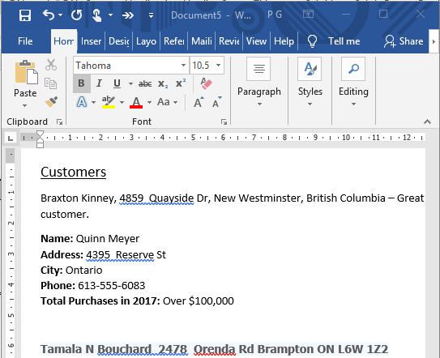


Text Files
https://upload.wikimedia.org/wikipedia/commons/2/23/Text-txt.svg
https://www.tcd.ie/disability/assets/images/teach-info/MS_word_DOC_icon.svg_.png

Slide 27
Text Files
Can you easily find or sort data?
Data Redundancies and Anomalies (Data can be easily duplicated and incorrect).
https://upload.wikimedia.org/wikipedia/commons/2/23/Text-txt.svg
https://www.tcd.ie/disability/assets/images/teach-info/MS_word_DOC_icon.svg_.png

Slide 28
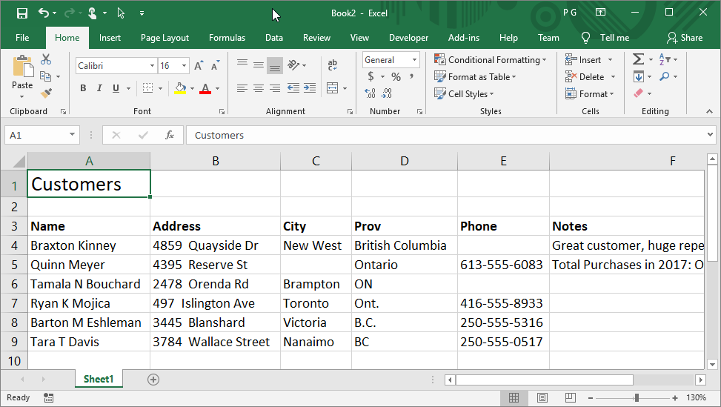
Excel

Slide 29

excel
Has some sorting ability
Limited data validation and consistency control
Single user: Open file marked as read-only. (Last person who saves wins).
https://upload.wikimedia.org/wikipedia/commons/thumb/e/ed/Microsoft_Office_Excel_%282013%E2%80%93present%29.svg/1200px-Microsoft_Office_Excel_%282013%E2%80%93present%29.svg.png

Slide 30
What Do Databases Do?
Store data
Multi-user with security
Full data validation
Enforce data consistency
Backup and recovery
Data analysis functionality
https://upload.wikimedia.org/wikipedia/commons/1/18/Database.svg

Slide 31
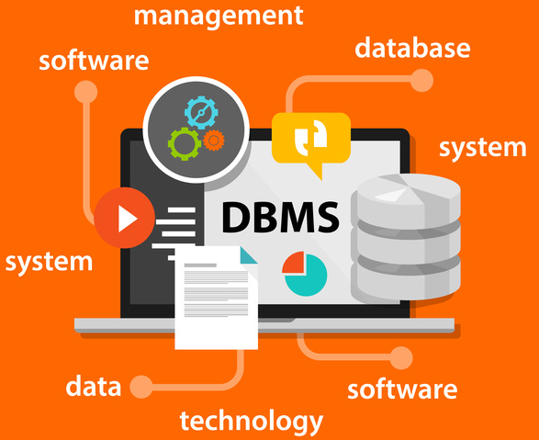
DBMS
Database Management System (DBMS)
More than just data.
https://kingfisherdata.com/wp-content/uploads/database-design.jpg

Slide 32
Metadata
Metadata = Data Dictionary
Controls what data goes into our database
Stores the data in a predictable logical way
Helps retrieving information fast
Helps sort, filter, link, classify data

Slide 33
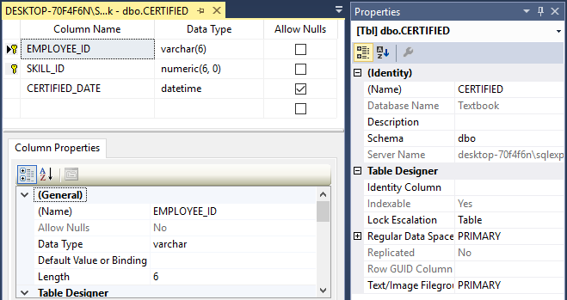
Metadata

Slide 34
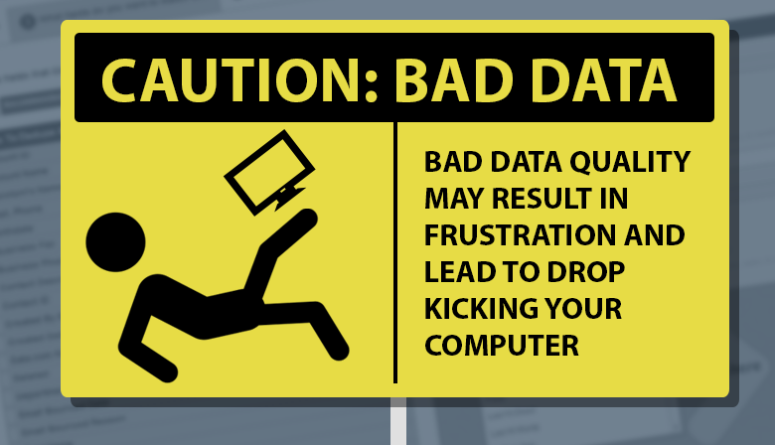
Control of our data
https://cdn-images-1.medium.com/max/1200/0*YCghEemt6BtW9OZV.png

Slide 35
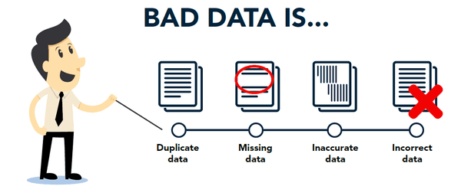
Control of our data
https://www.emailoversight.com/wp-content/uploads/2018/03/data-integrity.png

Slide 36
Control of our data
Address
4859 Quayside Dr, New West, British Columbia
4395 Reserve St, Mississippi Mills, Ontario
2478 Orenda Rd, Brampton, ON
3445 Blanshard, Victoria, B.C.
497 Islington Ave, Toronto, Ont.
3784 Wallace Street, Nanaimo, BC

Slide 37
Control of our data
House | Street | City | Province
4859 | Quayside Dr | New West | British Columbia
4395 | Reserve St | Mississippi Mills | Ontario
2478 | Orenda Rd | Brampton | ON
3445 | Blanshard | Victoria | B.C.
497 | Islington Ave | Toronto | Ont.
3784 | Wallace Street | Nanaimo | BC

Slide 38
Control of our data
House | Street | City | Prov
4859 | Quayside Dr | New West | 1
4395 | Reserve St | Mississippi Mills | 2
2478 | Orenda Rd | Brampton | 2
3445 | Blanshard | Victoria | 1
497 | Islington Ave | Toronto | 2
3784 | Wallace Street | Nanaimo | 1
ID | Prov
1 | BC
2 | ON

Slide 39
Pet Exercise
Which is better Design 1 or Design 2?
https://avada.theme-fusion.com/veterinarian/wp-content/uploads/sites/80/2016/11/pets_big.png

Slide 40


Lab
D2L: learn.bcit.ca
Use MySQL Workbench to:
Create a database
Create a table
Explore the metadata
Submit required screenshots
Complete by Thursday 11:30PM next week
http://sabreuse.com/wp-content/uploads/2013/06/red-submit-button-hi.png https://sos.tn.gov/sites/default/files/question_mark.jpg https://www.handybackup.net/images/icons/mssql-backup.png

